Slide 1
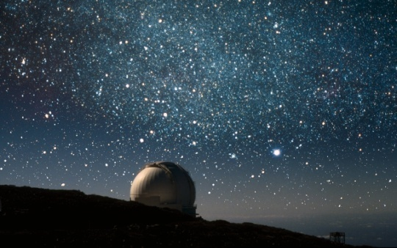
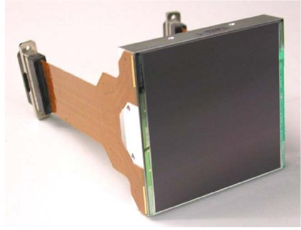
CCD Technology NEON School 2013
Dr. Simon Tulloch University of Sheffield
Photoelectric Effect
Charge collection
Basic CCD structure
Thinning
Charge Transfer
Blooming
Dark Current
Image defects
Cosmic rays
Fringing
Anti-reflection coats
Quantum Efficiency
Camera Construction
June 24th 2013

Slide 2
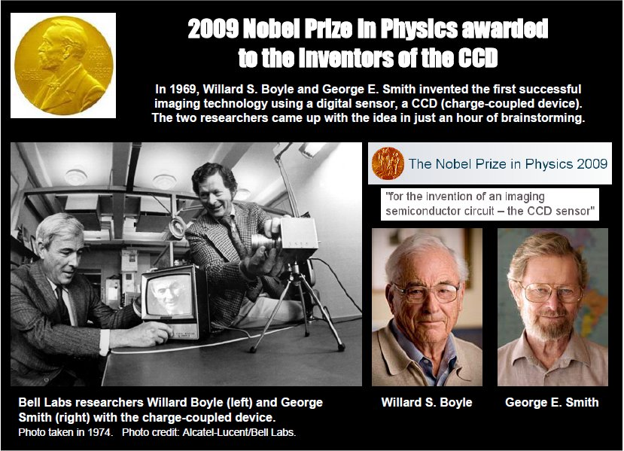
1.4. The CCD

Slide 3
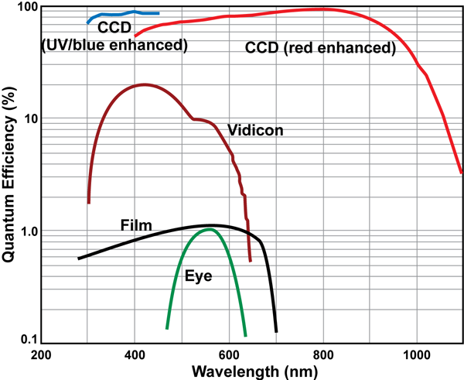
Quantum efficiency of astronomical detectors needs to be close to 100% if telescope time is to be used efficiently.

Slide 4
The Bucket-Brigade Structure
Just one amplifier for all the pixels. Charge is transferred pixel at a time to the amplifier at the edge of the pixel array.
RAIN (PHOTONS)
VERTICAL CONVEYOR
BELTS (CCD COLUMNS)
BUCKETS (PIXELS)
MEASURING
CYLINDER
(OUTPUT
AMPLIFIER)
HORIZONTAL
CONVEYOR BELT
(SERIAL REGISTER)

Slide 5
Read out proceeds until all pixel buckets have been measured.
`

Slide 6
Silicon is well matched to the visible spectrum
Useful range
Conduction band
1.1eV
Photon
Thermal
kick
Valence band
Bandgap in Silicon=1.1eV
An electron in the conduction
band or a hole in the valence
band are free to move around
the crystal.
1.26eV= energy of 1μm photon
1μm
360nm

Slide 7
The diode structure is the basis of most Silicon light detectors.
The simplest detector is the Photodiode which is shown below.
p n
“p-type” silicon
“n-type” silicon
depletion
conduction
valence
The band structure
is modified by the junction.
“depleted” silicon
Doped with
Boron
Doped with
Phosphorous
The Silicon junction

Slide 8
The key to using Silicon as an optical detector is to separate the hole and photo-electron before they can re-combine.
E-field low
E-field high
E-field low
p-type Si
Insulating
Depletion
region
n-type Si
Conduction band
Increasing potential energy
Valence band
Electron-hole pairs created in the depletion region are separated.
Elsewhere they can be lost through recombination.

Slide 9
Some extra structures are added to the Silicon junction to create a CCD. A simplified view of a single
pixel is shown below.
Buried Channel CCD (1 pixel in cross-section)
Clock phases
-V +V -V
1μm
Potential (volts)
Region of most positive potential within Silicon bulk.
n
p
SiO₂
metal or polysilicon

Slide 10
The structure is repeated across the CCD surface.
+ve electrodes produce a potential well that defines
a pixel.
Every 3rd electrode held positive to define pixels
Clock phases
-V +V -V
-V +V -V
-V +V -V
p
SiO₂
metal or polysilicon

Slide 11
Implementation in Silicon
Electrodes
SiO₂
Silicon
J.Beletic, Teledyne

Slide 12
Scientific CCDs are usually “backside illuminated” to
avoid absorption of light in the electrodes.
“Front-side” illumimated
“Back-side” illumimated
Cheap
Low sensitivity
Very expensive
Very sensitive

Slide 13
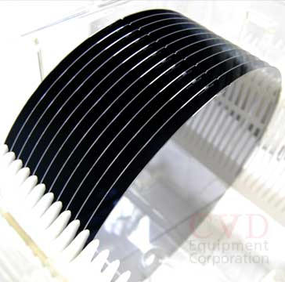
The Silicon that forms the optically sensitive part of the CCD is deposited epitaxially on a Silicon wafer substrate.
Silicon wafers,
ready for processing
n
0.5μm
Depletion
Epitaxy
25μm
p
600μm
Wafer
Vapor-phase Epitaxy.
A form of chemical vapor
deposition (CVD)
p+
SiCl₄+2H₂- Si +4HCl
Electrical potential
“field-free”
800-1100⁰C
Any photo-electrons
generated here
are lost
Epitaxial layer
Wafer

Slide 14
Thinning
The solution is to chemically etch away the silicon substrate leaving just the epitaxial layer.
Electrical potential
Chemically etch
Photons entering from the back side are now absorbed in a region containing a potential gradient (i.e. a region with an electric field) and the photo-electron is detected.
The resultant CCD may only be 17μm thick which leads to mechanical complications.

Slide 15
“Picture frame” approach
Light input
CCD Ceramic
package
Bond wires
Connector pins
“Whole wafer” approach
Epoxy
Wafer

Slide 16
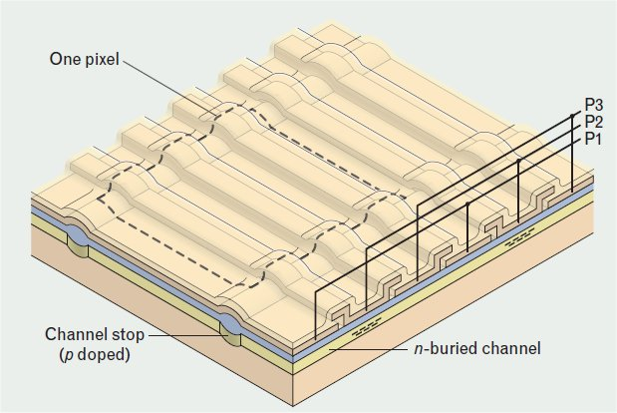
Pixels are defined in the 2nd dimension by “Channel Stop” structures.
Electrodes take the form of strips lying parallel to the image rows.
J.Beletic, Teledyne
Barry Burke, MITLL

Slide 17
The same electrode structure used to collect the charge can also be used to transfer the charge during the readout process.
+5V
0V
-5V
1
1
2
+5V
0V
-5V
3
3
+5V
0V
-5V
2
So the electrons always seek
the most positive potential
Time-slice shown in diagram
Very efficient design: same structure
used to collect charge as is used to transfer charge

Slide 18
A second “conveyor belt” at right angles to the first is required to transfer each row, pixel at a time to the output amplifier. This is known as the serial register.
Image Area
Also described as the
parallel register
Serial Register.
Also widely described as:
“The register” or
”The horizontal register”
On-chip amplifier at end of the serial register. This
converts the pixel
charge into a voltage

Slide 19
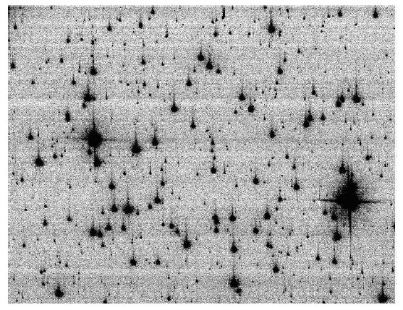
The transfer of charge is not always perfect.
This can be due to failure in the camera electronics
or, in the case of space-based CCDs, radiation damage.
Raw Hubble ACS/WFC image. Marco Chiaberge , Pey Lian Lim, STSci

Slide 20
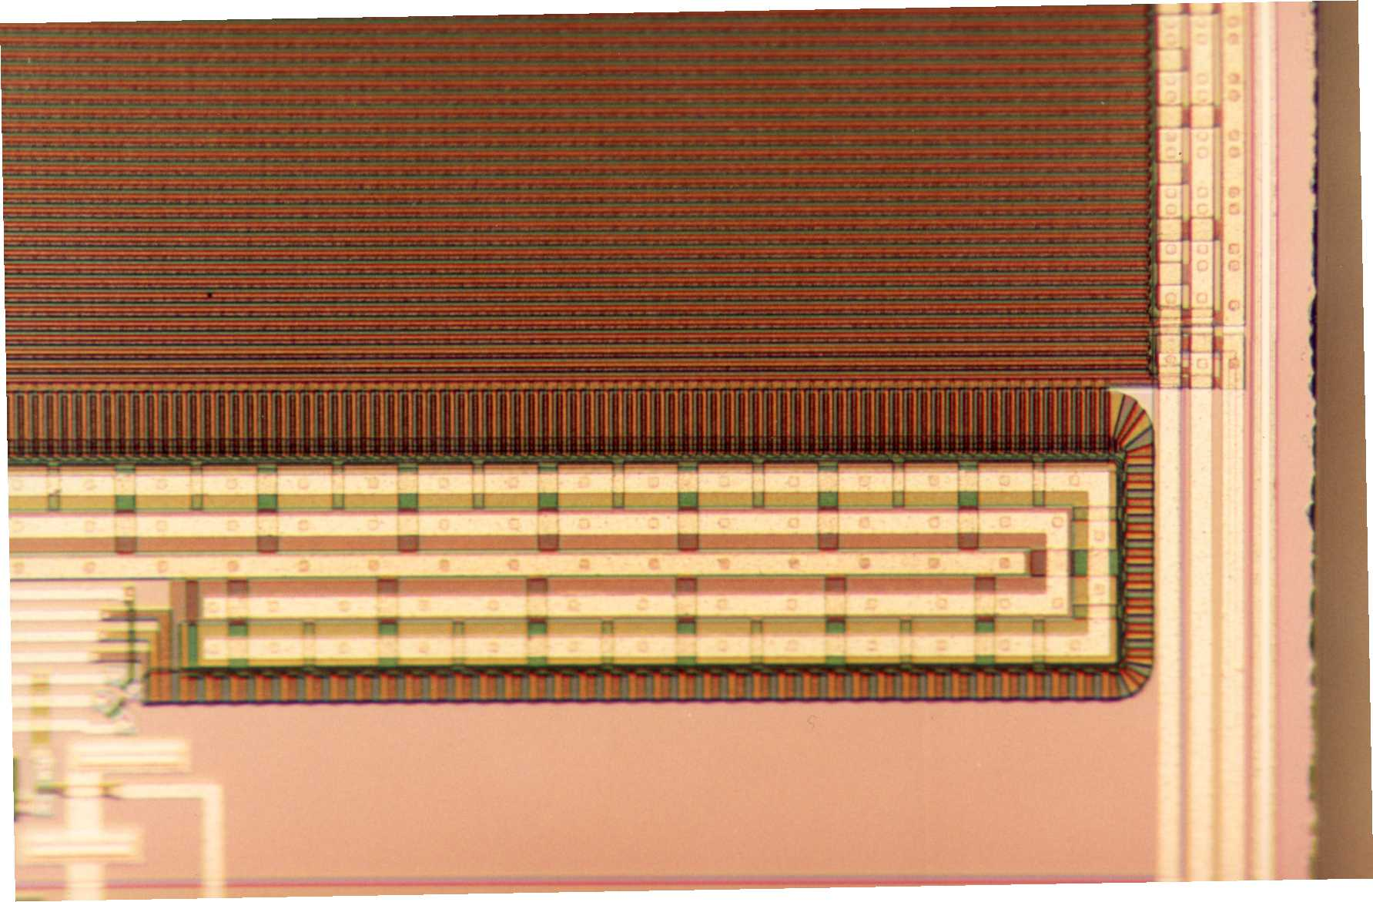
Implementation of parallel and serial registers in Silicon
1mm
Image Area
Serial Register
Bus wires
Bus wires
Edge of
Silicon
Read Out Amplifier
Photomicrograph of a corner of an EEV CCD4280.

Slide 21
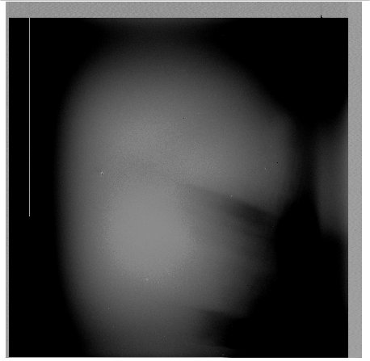
Bias Areas
Pattern noise
“y-overscan”
Also known
as “Parallel-
Overscan”
Bias regions (i.e. underscan and overscan) are important for the proper analysis of scientific images
Light sensitive
image area
“x-underscan”
Also known as “Serial
Underscan”
“x-overscan”
Also known as “Serial-
Overscan”
blocked column
Dust
Readout
direction
SITe 2kx2k CCD. –ve image.

Slide 22
Full well and Blooming
The potential wells created within each pixel by the vertical phase voltages have a limited capacity known as the full well.
Blooming Full Well
Surface Full Well
V+
V+
V+
Potential wells under pixels
Blooming full well is reached at approximately 150ke⁻ for a 15μm pixel CCD.
Blooming does NOT conserve charge.

Slide 23
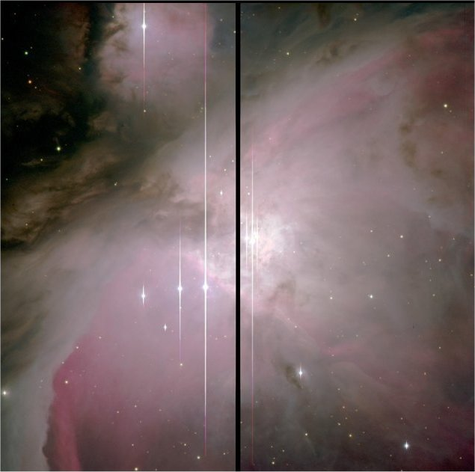
Blooming full well in an astronomical image
M42 Nik Szymanek

Slide 24
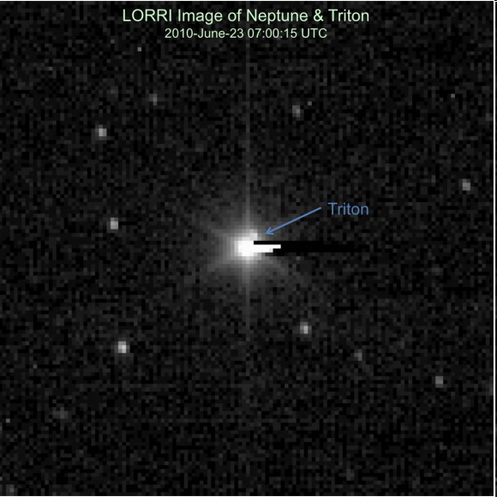

Another bloomed image
NASA New Horizons mission
E2V CCD47-20
FT CCD
NASA New Horizons Pluto probe
This time the blooming is in the serial register

Slide 25
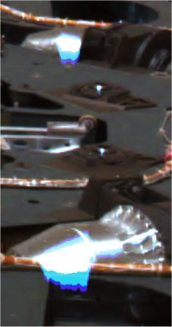
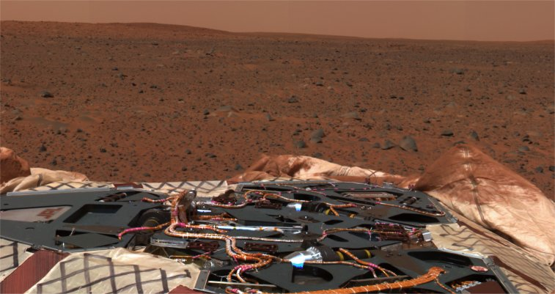
Image exhibiting blooming.
NASA/JPL Mars Exploration Rover
Surface full well

Slide 26
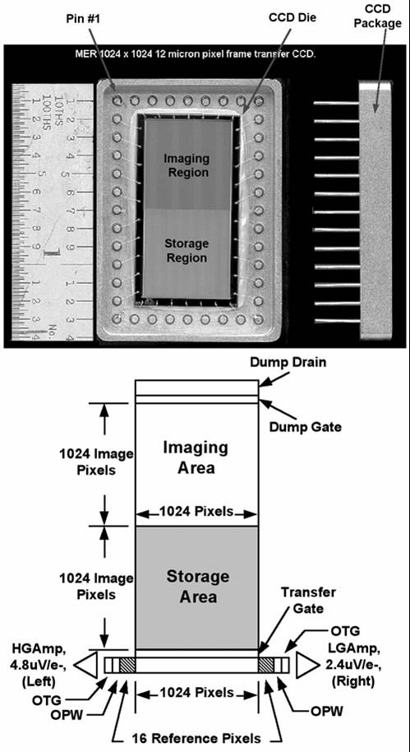
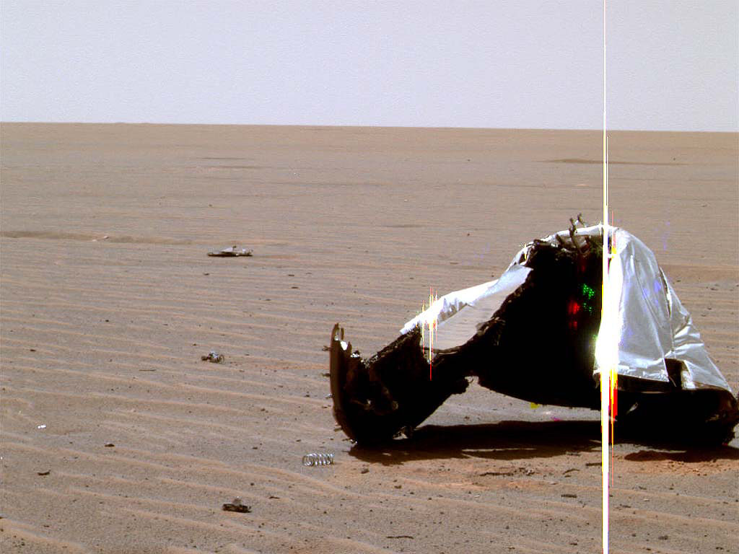
Another image from Mars!
NASA/JPL Mars Exploration Rover
Dalsa custom “Frame Transfer” CCD
Blooming full well

Slide 27
Dark Current
Thermal motion of silicon atoms can produce an electron-hole pair indistinguishable from a genuine photo-electron.
probability
Bandgap energy 1.1eV
cold
These electrons have enough energy
to jump from valence to conduction
band
warm
warmer
Electron energy
0.026eV at room temperature
At room temperature dark current can saturate a pixel in a few seconds.

Slide 28
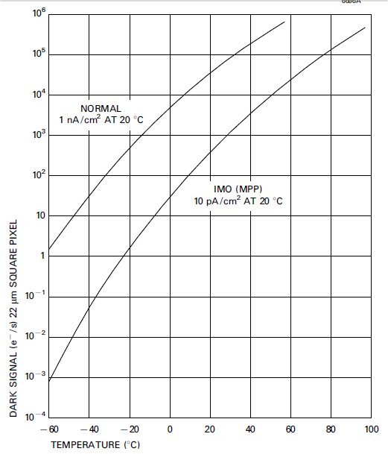
Scientific CCDs need to be cooled to eliminate dark current.
Typical operational temperature
is -110ºC where dark current is
negligible.
E2V technologies

Slide 29
Reducing dark current using a liquid nitrogen cryostat.
Liquid Nitrogen (LN₂)
Latent heat of Evaporation =200 kJ kg⁻¹
Density=0.81 kg Litre⁻¹
Example: 6 litres of LN₂ can give 11 Watts of cooling for 24 hours
Thermally Electrical feed-through Vacuum Space Pressure vessel Pump Port
Insulating
Pillars
Face-plate
Telescope beam
.
Specific heat capacity
of Nitrogen gas= 1kJ kg⁻¹ K⁻¹
.
.
Boil-off
MLI
Optical window CCD CCD Mounting Block Thermal coupling Nitrogen can Activated charcoal ‘Getter’ to improve vacuuum
Focal Plane
of Telescope

Slide 30
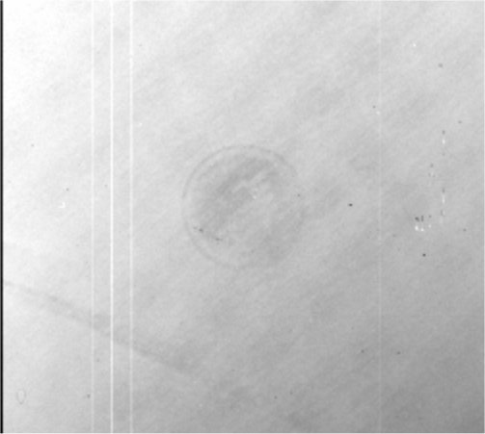
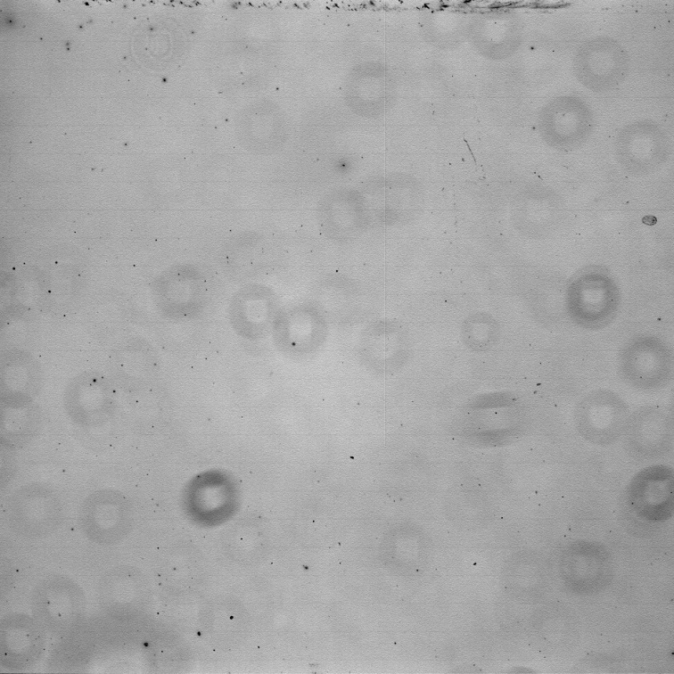
Image defects
Manufacturing marks.
Dust on the optics.
watermark
Produces “dust donuts”
Blue flat field CCD4280
Generally more visible in the blue.
“anti-pupil” images from dust on
camera window.

Slide 31
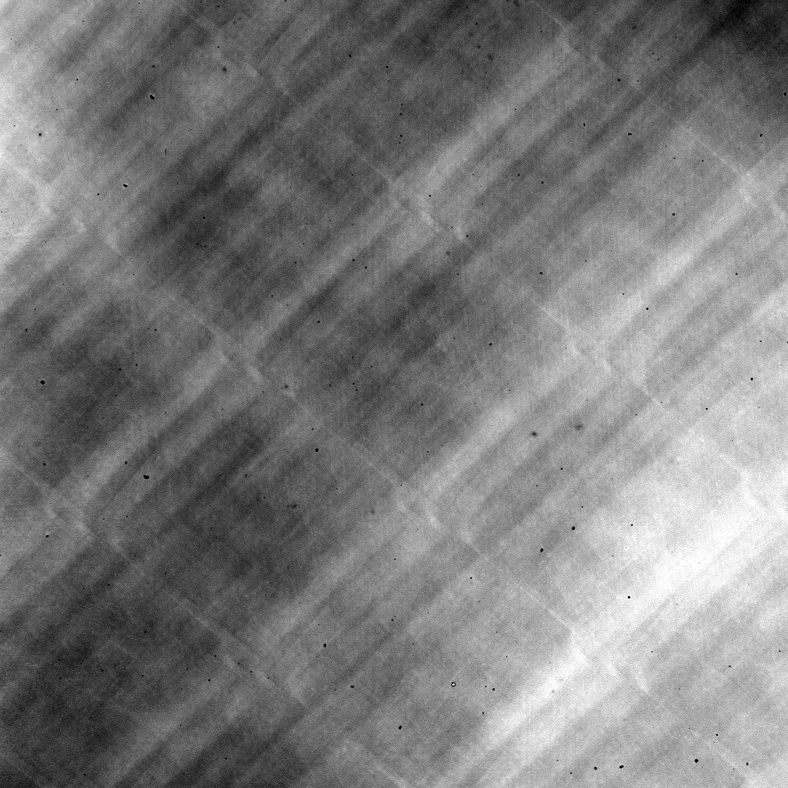
Laser Annealing Pattern
Caused by manufacturing process. Visible only in blue flat-fields

Slide 32
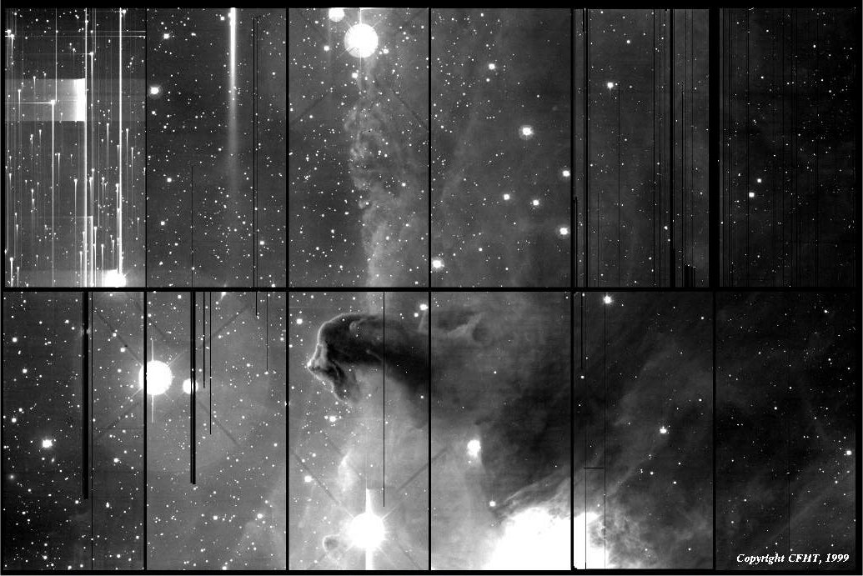
1.4. The CCD
This CCD mosaic demonstrates the effect of blocked columns and traps
Some CCDs have since been replaced.
Canada-France-Hawaii Telescope. (J.-C. Cuillandre).

Slide 33
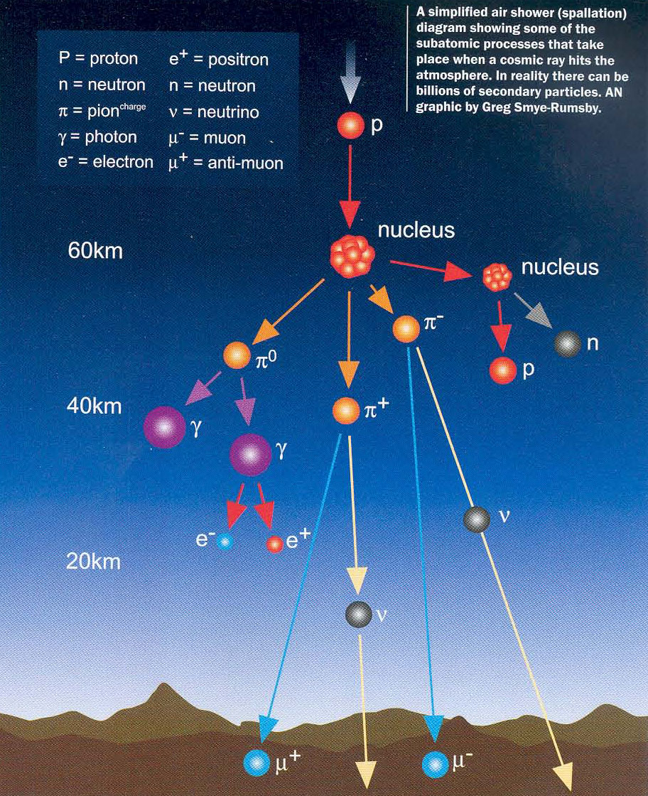

Cosmic Rays
High energy particles from space
Long dark exposure
98% of linear tracks due to Muons
Mark Downing, ESO
Muon
Highly Penetrating: average energy 4GeV.
500m of rock will absorb 99.9% of the muons.
Mean charge delivered by cosmic rays is
approx. 1 e⁻ per pixel per hour.

Slide 34
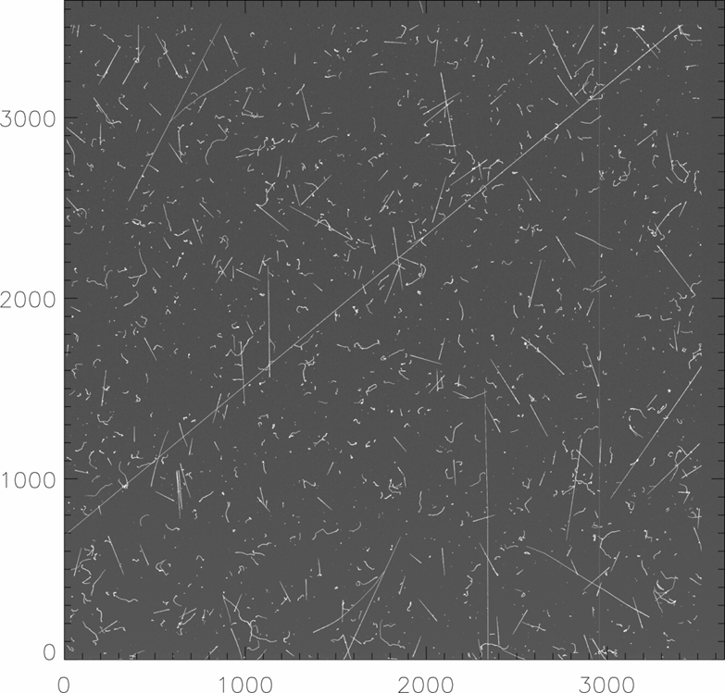


Long dark exposure
Other cosmic ray features
called “worms” actually have
a terrestrial origin.
Steve Holland
γ
γ
Silicon
γ
Recoil electron
Camera
structure
Compton scattered γ-ray

Slide 35
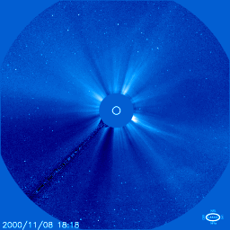
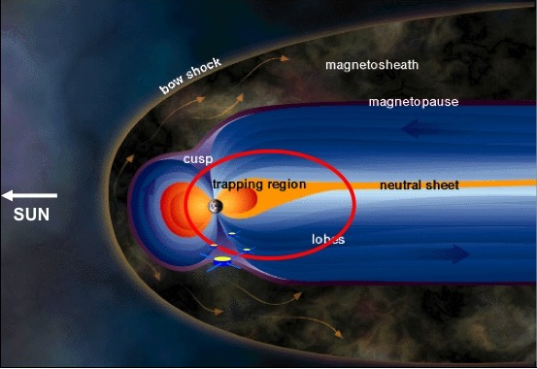
CCDs in Space suffer badly from cosmic rays
ESA
Coronal mass ejection seen from SOHO (outside of magnetosphere). Many charge particle tracks visible in this sequence of CCD images.
Protons and heavy ions with energies of GeV.
Earths magnetic field deflects some charged particles giving protection at lower altitudes.

Slide 36
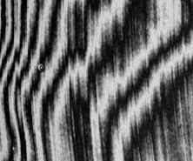
“Fringing”
The fringes are effectively contour lines showing how the CCD thickness varies over its surface.
Thickness of CCD here= d
Thickness of CCD here= d ± λ/2
(where λ is the wavelength in Silicon, not air)
Appearence of fringes in a thinned CCD illuminated with
900nm light. Fringe amplitude 50%. Image: ESO

Slide 37
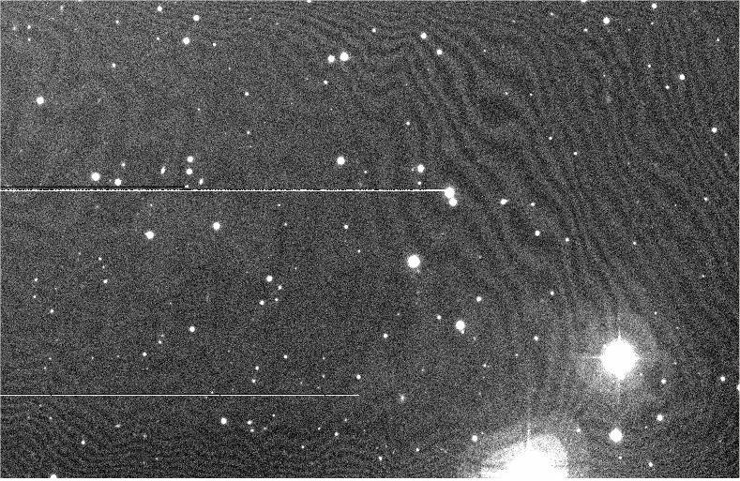
Fringed sky-lines, Isaac Newton Telescope WFC

Slide 38
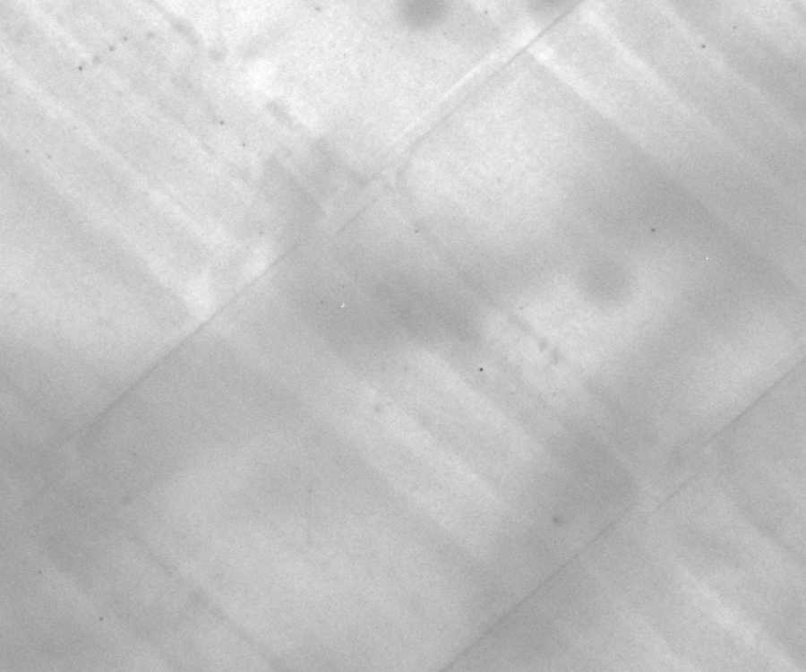

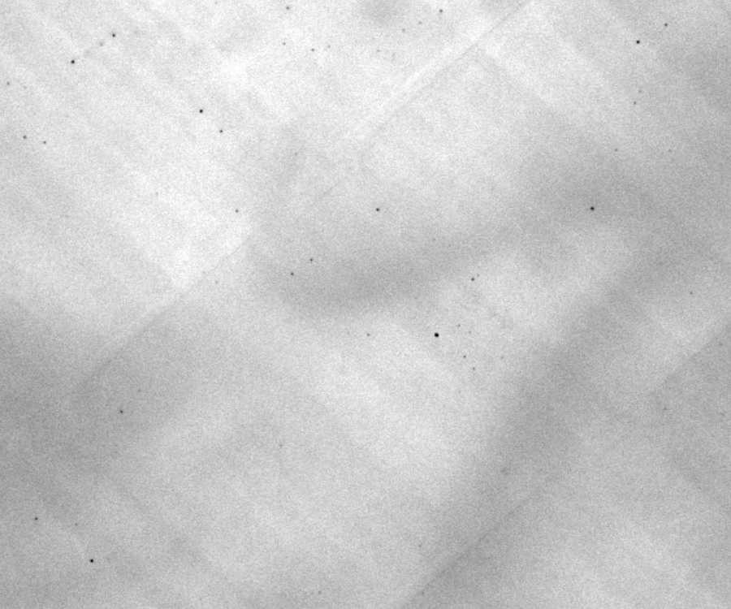
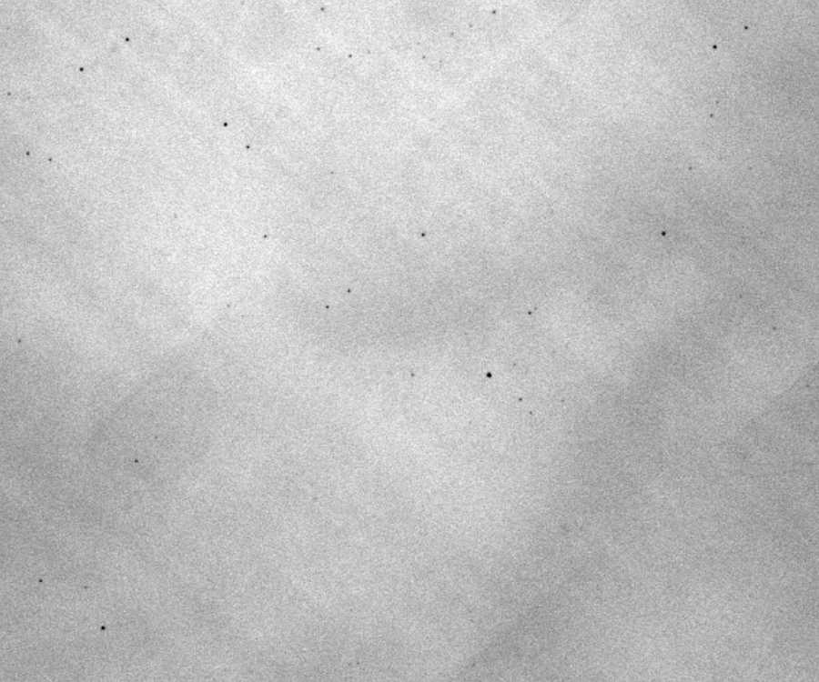
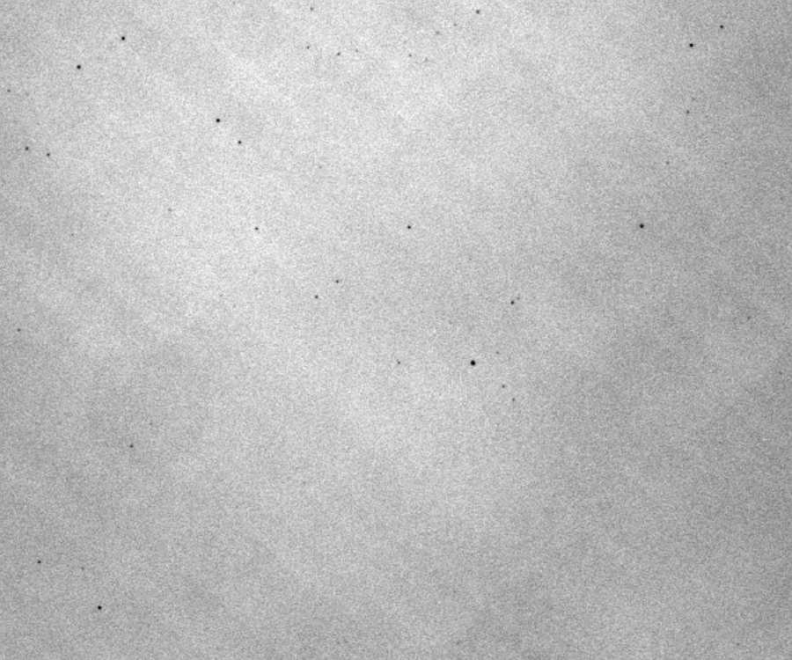
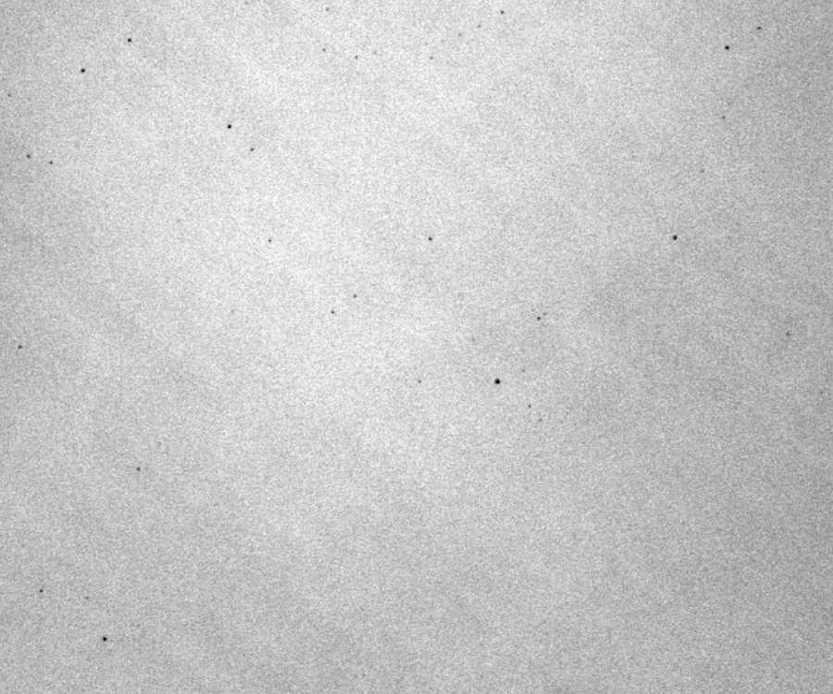
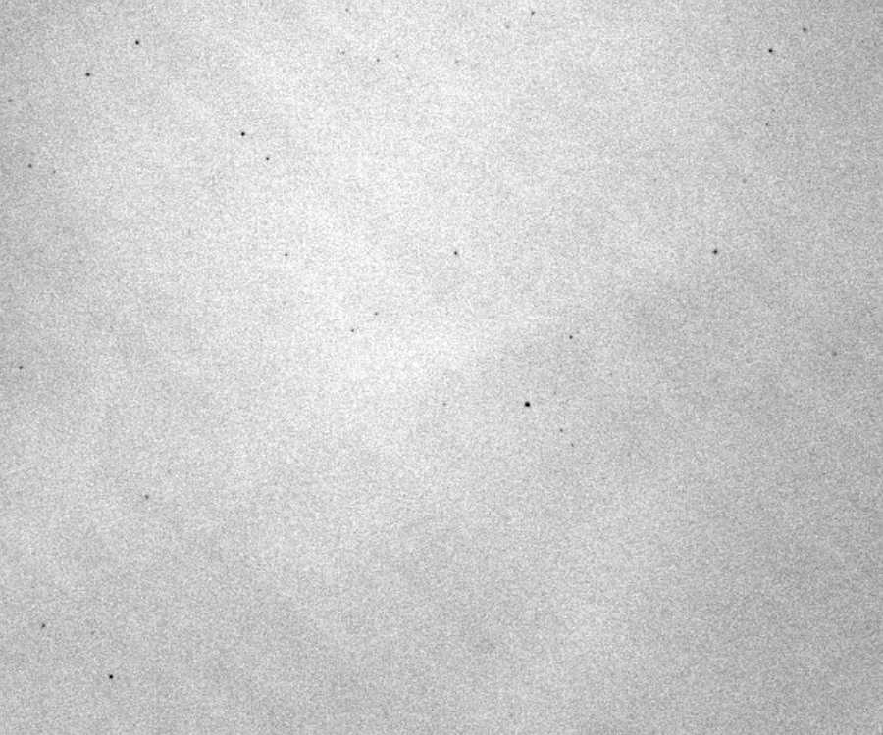
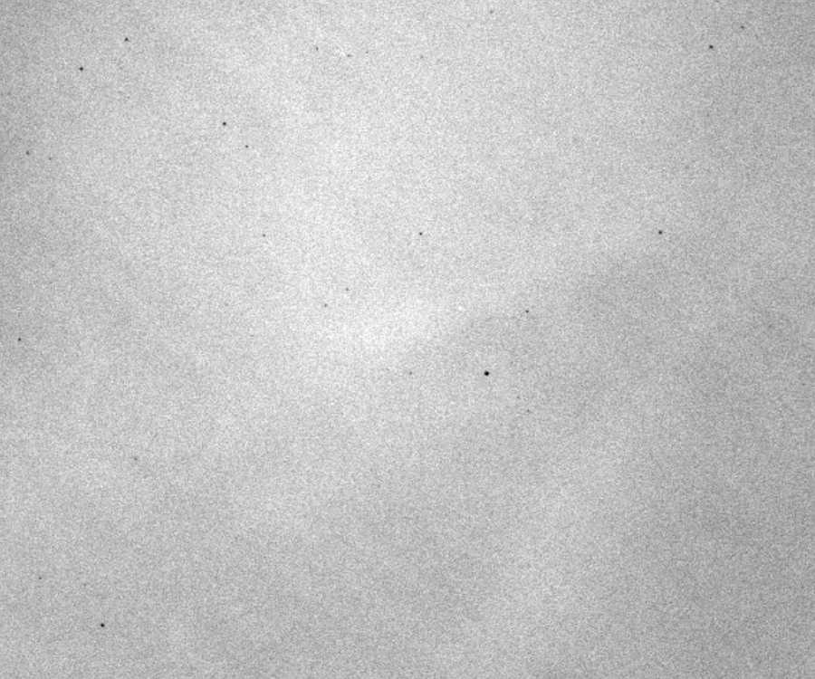

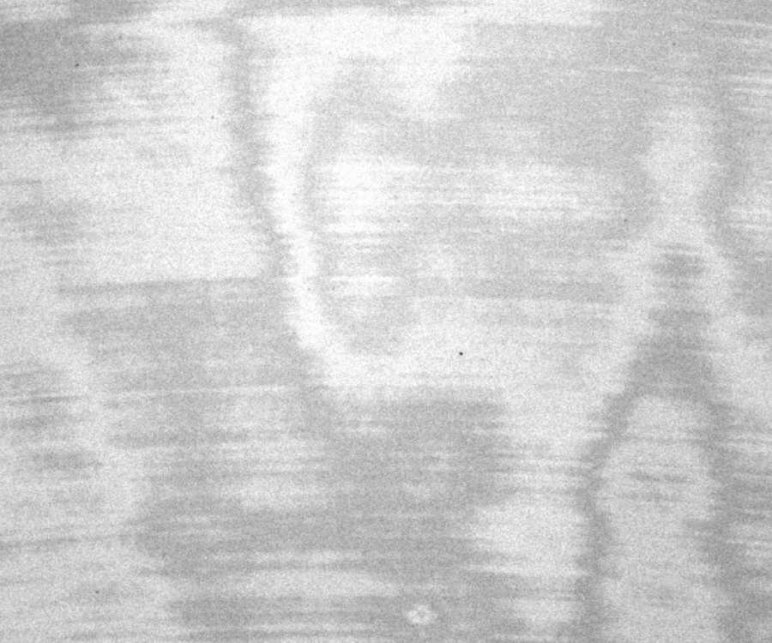
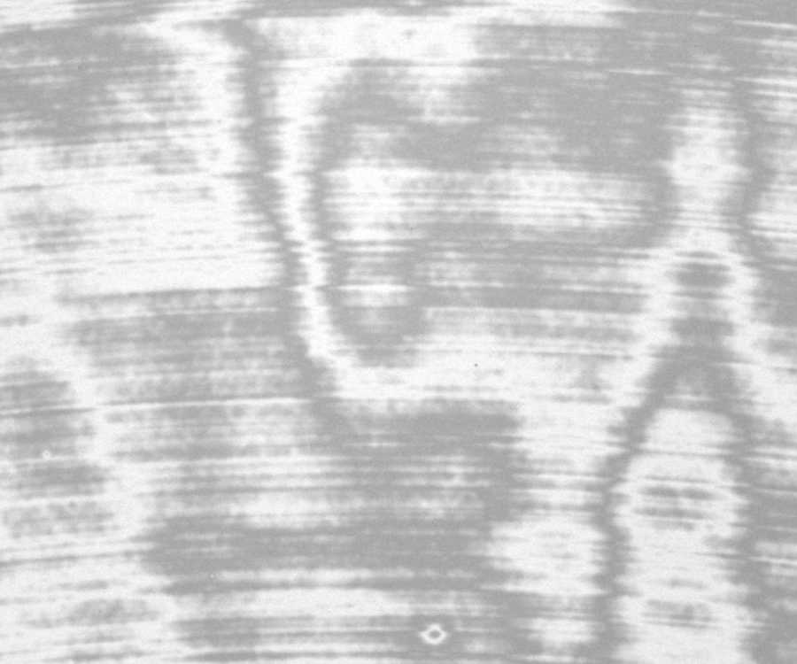
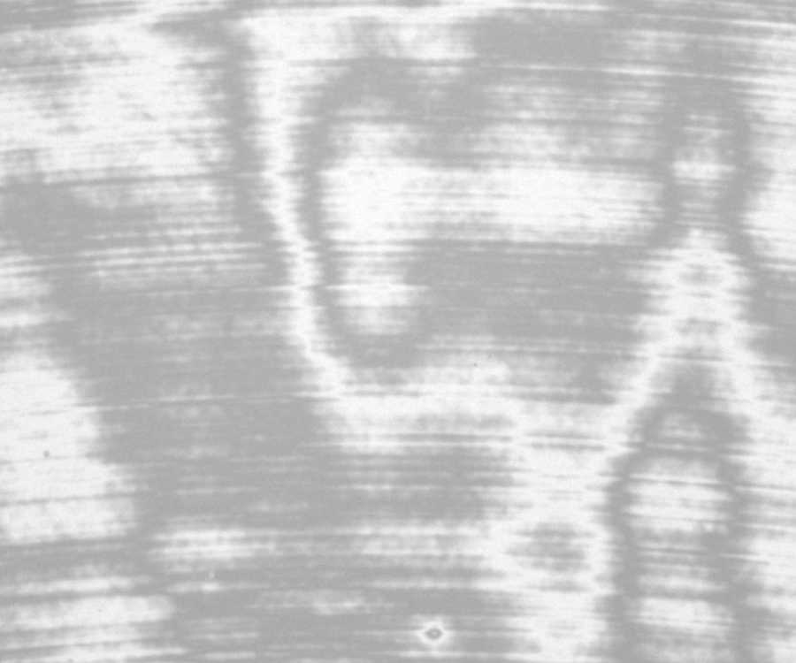
Flat-field sequence illustrating laser-annealing features and fringing.
Ralf Kohley.
350 nm
365 nm
436 nm
500 nm
546 nm
600 nm
650 nm
700 nm
800 nm
900 nm
950 nm
990 nm
E2V CCD47-20 (1kx1k, 13um, AIMO, thinned), ~500x500 pixel area seen

Slide 39
Silicon detectors need to be thick enough to absorb
the wavelengths of interest
Incident light
400nm
200nm
Absorbtion lengths (L) in Silicon
550nm
2μm
650nm
4μm
800nm
15μm
1
f(x) = exp(-x/L)
Fraction transmitted f(x)
Distance into silicon (x)
Absorption length L
Thin sheets of Silicon appear red in transmission

Slide 40
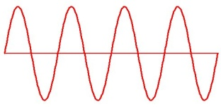
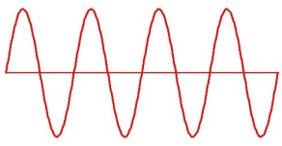
Explanation of Fringing
The Fabry-Perot etalon
thickness=d
= block of dielectric material
E.g. Silicon at the
red end of the spectrum
where it becomes partly
transparent.
Light can only enter
fully if the etalon is
resonating i.e. if it
contains a half-integral
number of wavelengths.
n=1,2,3……
d=nλ/2
d=(2n-1)λ/4
Light enters the
etalon.
Light prevented from entering the etalon.
Bright fringe
Dark fringe

Slide 41
2.1. CCDs: Boosting performance of the basic design
Actual behaviour of a 17μm thick CCD
E2V CCD4280
Useless in this range,
for spectroscopy and
narrow-band imaging.

Slide 42
The solution is to use thicker Silicon. Such CCDs are generally described as “Deep Depletion” types.
Fringing is reduced and red-end sensitivity is also boosted

Slide 43
Anti-Fringing Structures
Can eliminate fringing at a specific wavelength by profiling the pixel depth
A
1 pixel
50% of pixel is λ/4 thinner
λ/4 step
p+
n
p
p+
A
d
Pixel cross section
Section A-A
Whenever a bright fringe falls
in the centre of the pixel, a dark fringe
falls at the edges: cancellation of fringe.
When d=nλ/2 bright fringe
When d= (2n-1)λ/4 dark fringe

Slide 44
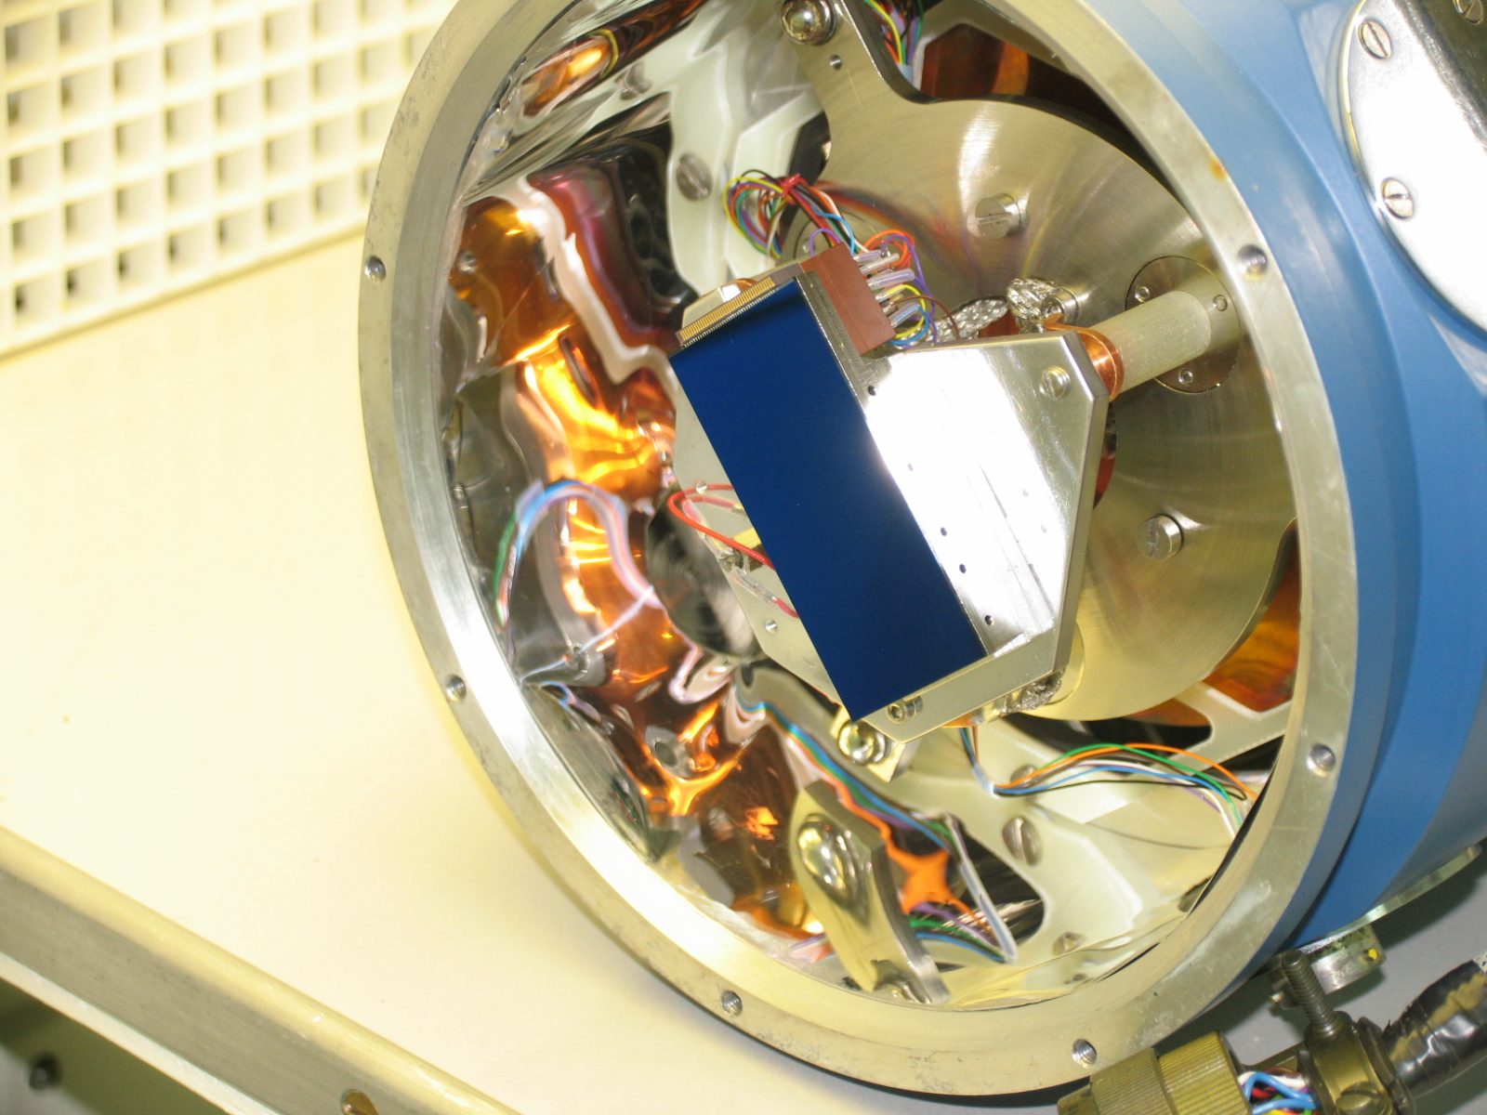
Results from a CCD4482 with anti-fringing process
ING “RED+” detector
+/- 2%

Slide 45
Anti-reflective (AR) coatings.
Silicon has a large refractive index (approx 4.0) which means it is hard for light to enter. An AR coat is essential.
n_{i}
Air
¼ wavelength thick
n_{s}
AR coating
Of course the zero reflectivity will only occur at one specific wavelength.
n_{t}
Silicon
[ ]
(n_{t} x n_{i})-n_{s}
2
2
The reflected portion is now reduced to :
In the case where the reflectivity actually falls to zero! For Silicon we require a material with n = 1.9, fortunately such a material exists, it is Hafnium Dioxide. It is regularly used to coat scientific CCDs.
(n_{t} x n_{i})+n_{s}
2
n_{s}
n_{t}
2
=

Slide 46
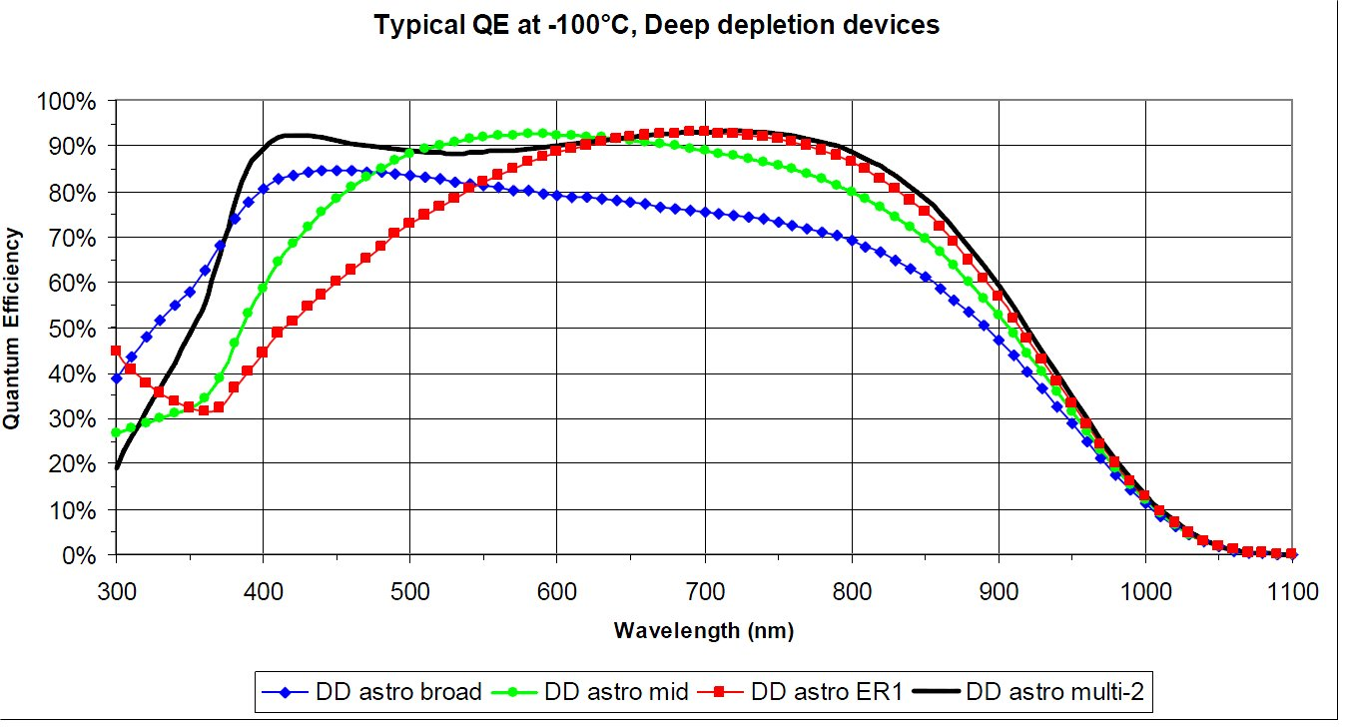
Quantum Efficiency (QE) = proportion of incident photons that produce a measurable photo-electron
Various AR coat options shown for an E2V scientific CCD.

Slide 47
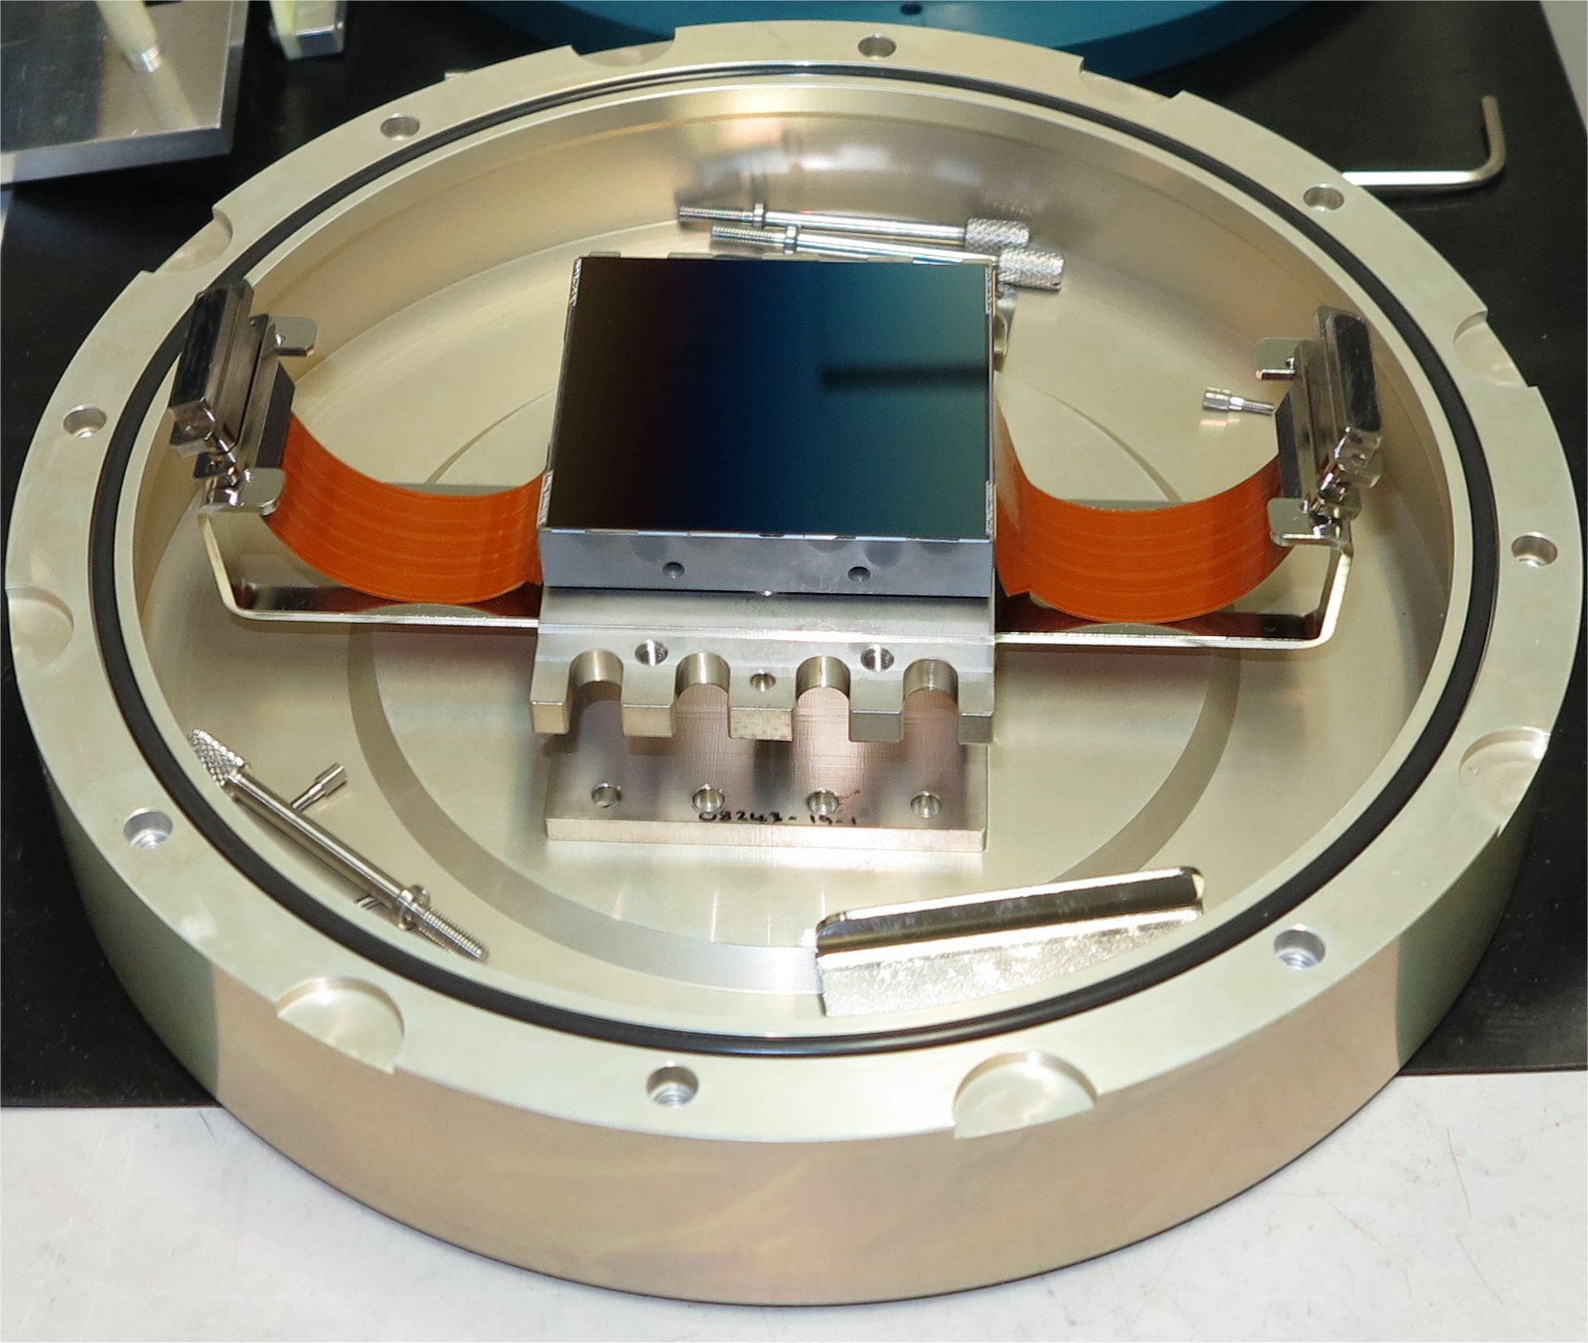
A typical cryogenic CCD camera
4k x 4k deep depletion CCD: CCD231,
in its transport box.

Slide 48
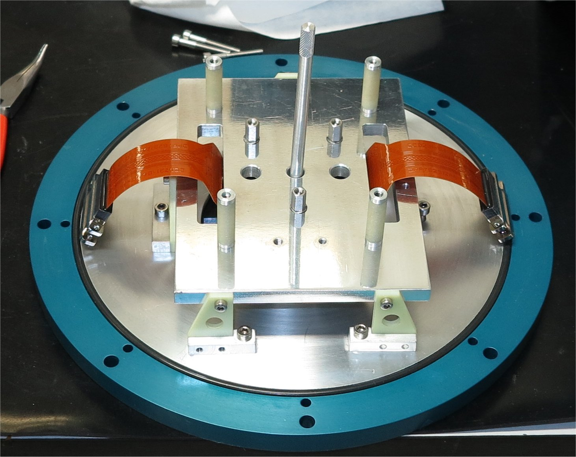
A typical cryogenic CCD camera
CCD mounted on support structure
above an optical window

Slide 49
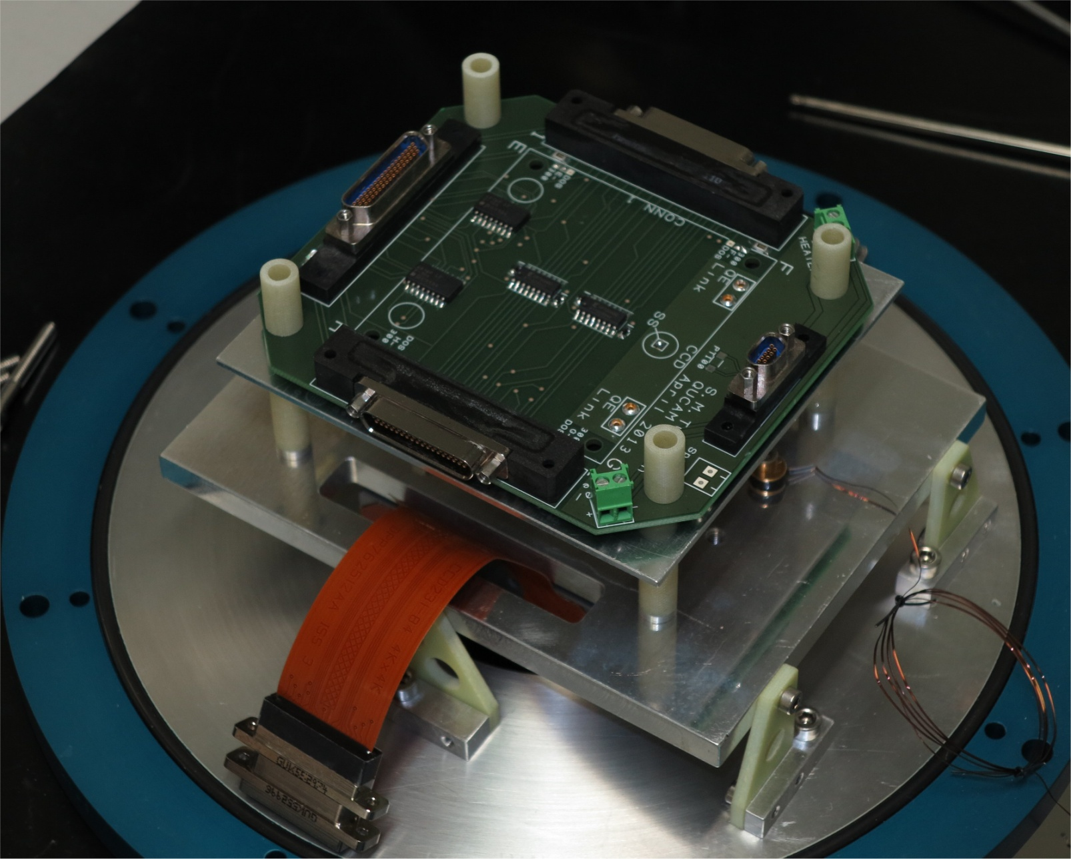
A typical cryogenic CCD camera
Protection circuitry added

Slide 50
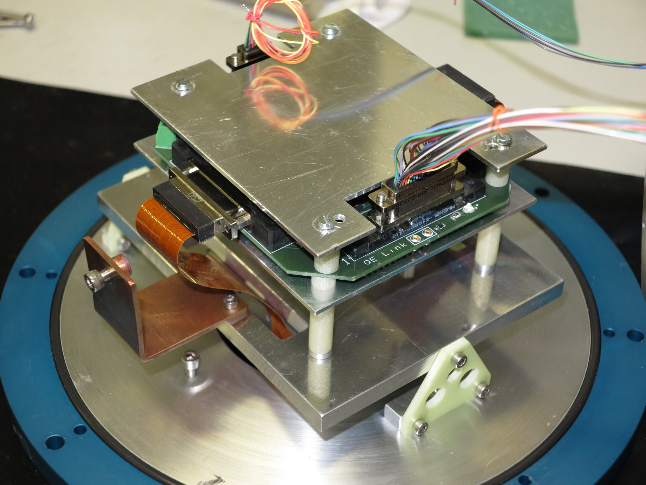
A typical cryogenic CCD camera
CCD connected. Radiation shielding added

Slide 51
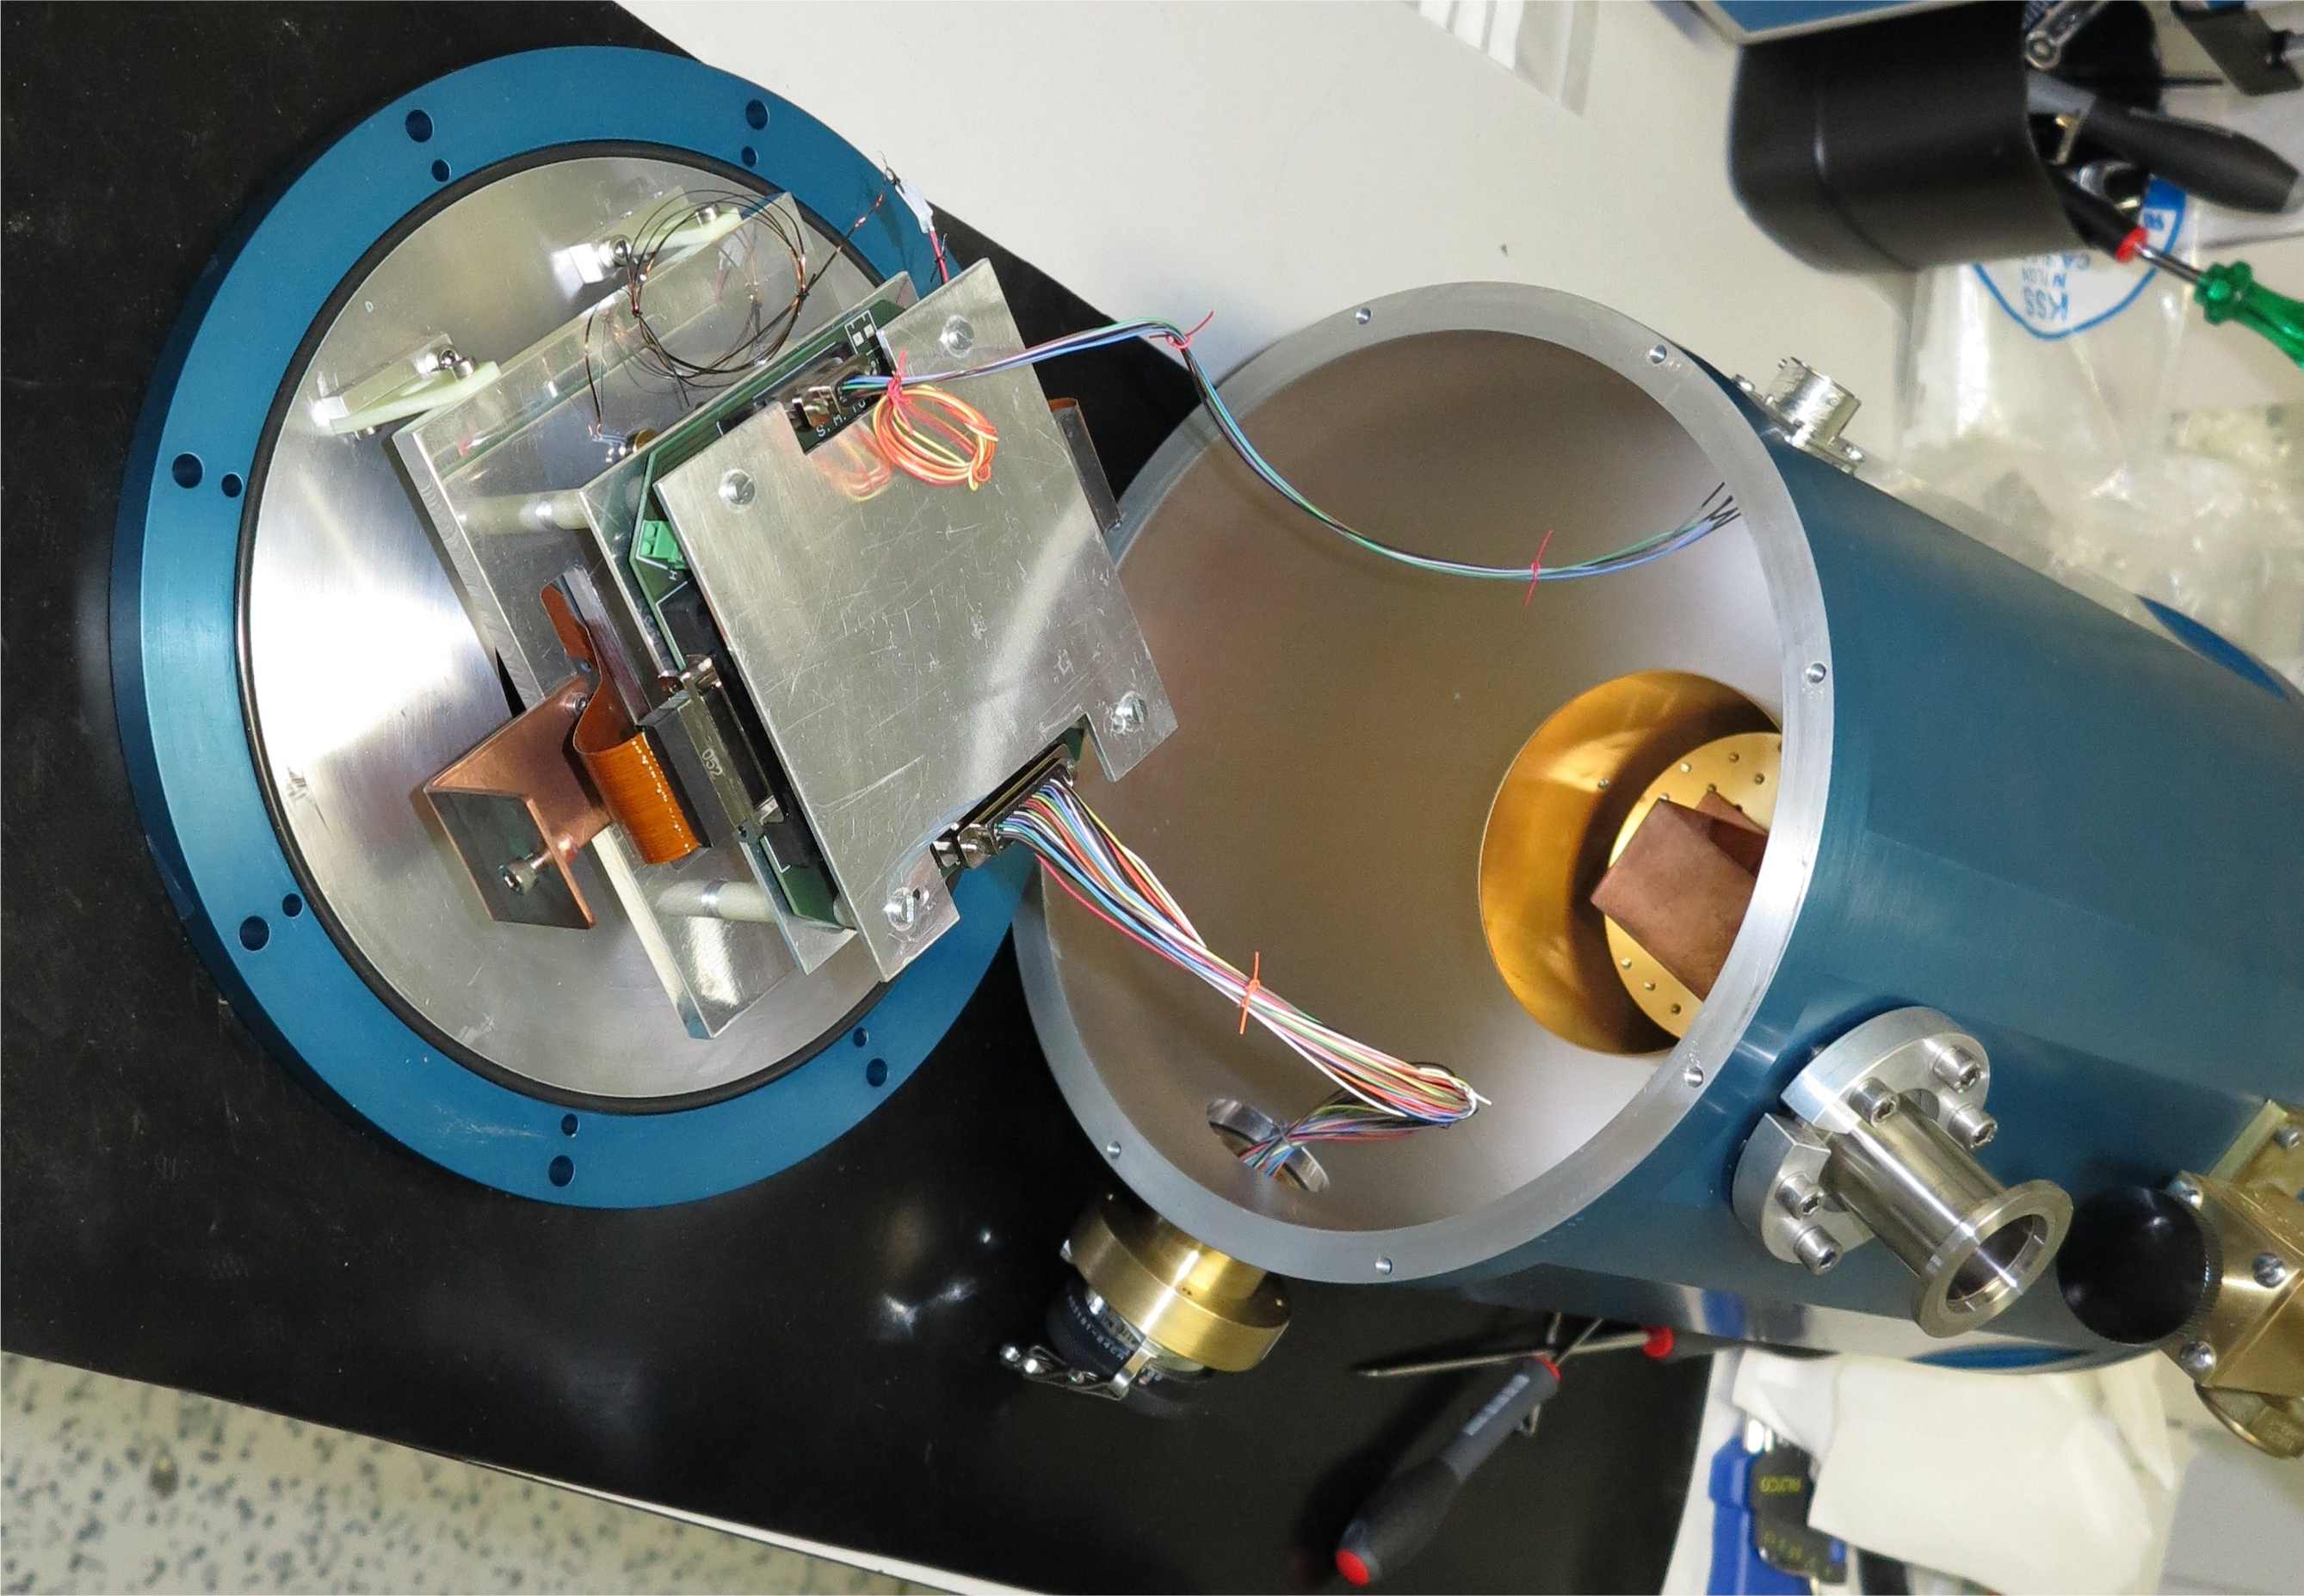
A typical cryogenic CCD camera
Cryostat then closed up

Slide 52
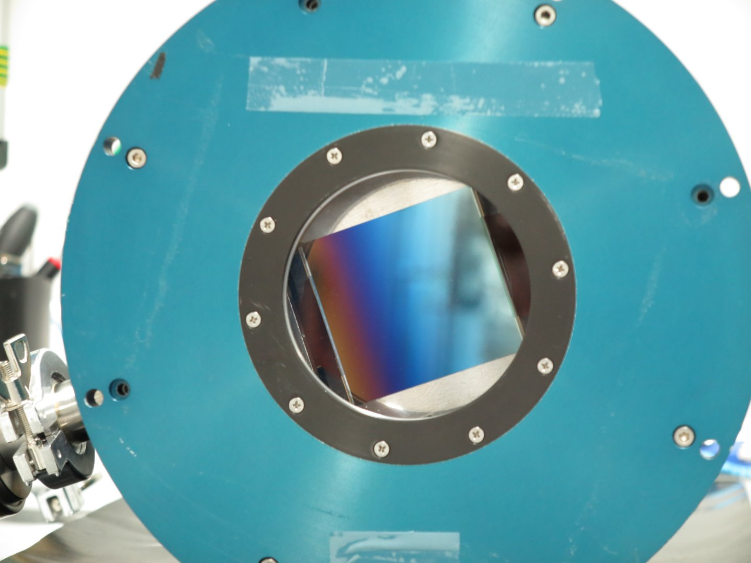
A typical cryogenic CCD camera
View in through window

Slide 53
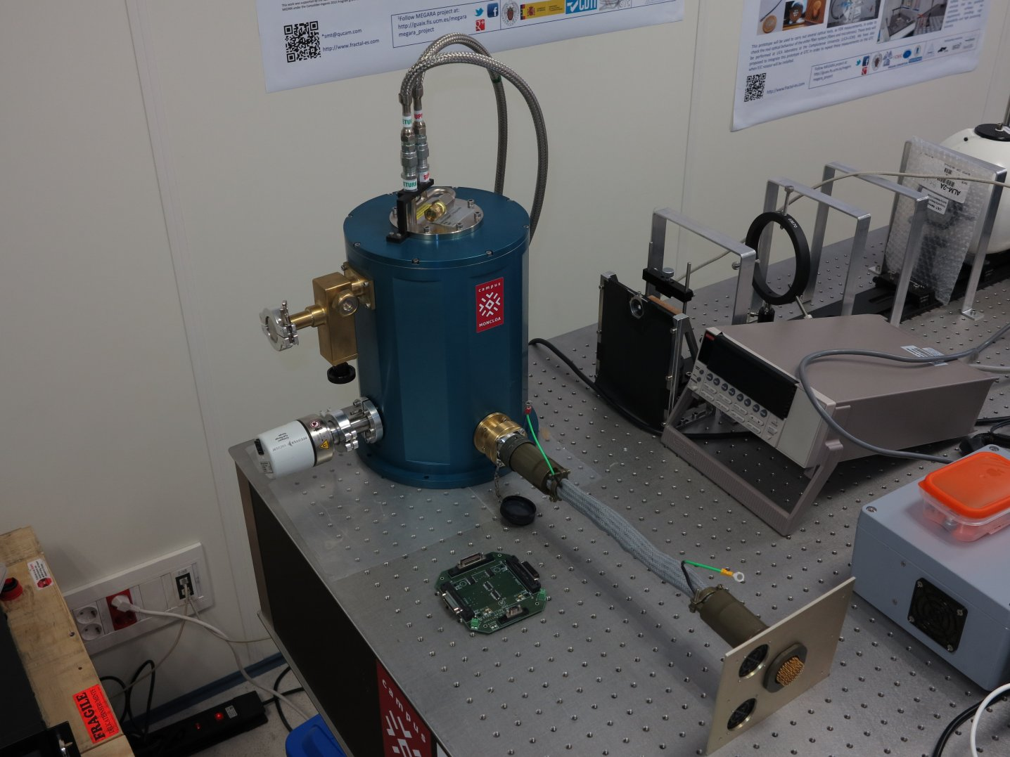
A typical cryogenic CCD camera
Finished camera

Slide 54
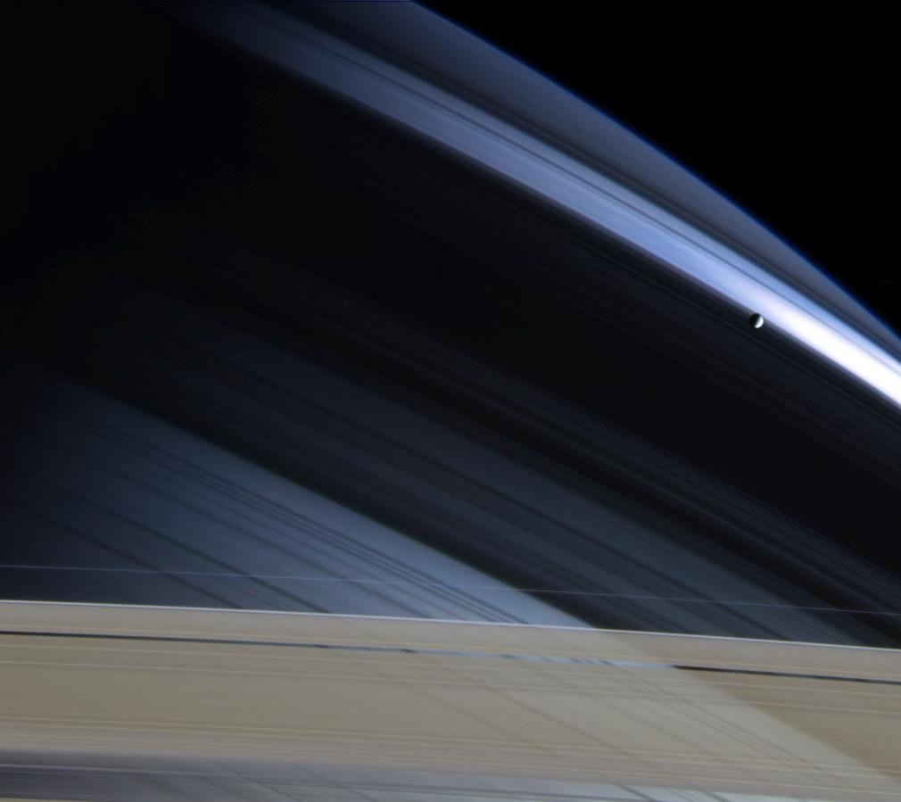
End of Presentation

